Slide 1







Threat Assessment in Pennsylvania’s K-12 Public Schools

Slide 2

Preliminaries
Administration
Alarms, exits and restrooms
Timings
Cellphones
Lunch
Session expectations
This is the time and space to be inquisitive – a safe environment
Ask questions – challenge, explore, inquire
Be positive, active engagement
A good colleague – courteous in disagreement(!) and collaborative in co-working on answers
Complete the Session Evaluation at the end of the day – and be candid!

Slide 3
Preliminaries
Between you and me…
My background
Your trainer and facilitator
Creating collegial networks within PA for the collective benefit of Threat Assessment (TA) practice…
…introduce yourself during the breaks, and share contacts at the end of the session

Slide 4

Why we are here…
Pennsylvania law requires Chief School Administrators to establish a Threat Assessment Team (TAT)
For the assessment of and intervention with students whose behavior may indicate a threat to the safety of the student, other students, school employees, school facilities, the community or others
You are at the front line of averting acts of targeted violence
Research tells us that targeted violence is, in almost all cases, preventable
Keep a Record: Commit to a handful of practically achievable actions when you get back to work!
Extending your learning: Look out for the icon and the searchable internet references throughout the training

Slide 5
PCCD’s Model Procedures and Guidelines
PCCD’s Model Procedures and Guidelines: based on PA law and established standards of practice
Not prescriptive – school boards have authority to establish any policies or procedures that are consistent with applicable laws and regulations
This training is directly aligned to the PCCD Models
Wide range of resources; provide the legal and administrative context
PCCD Model K12 Threat Assessment Procedures and Guidelines

Slide 6
What are we seeking to accomplish?
Training Goal
To provide participants with an understanding of why violence prevention is possible and how behavioral threat assessment and management enables schools to identify, assess and intervene to avert potentially violent situations and manage students posing a risk for violence and situations of concern over time through the development of a holistic understanding of the factors pushing or pulling an individual along a pathway to violence
Intent: De-mystify the process, reduce anxiety, and increase skills and knowledge in the domain of Behavioral Threat Assessment and Management

Slide 7
Section 1 | Introduction and Rationale for the Threat Assessment Approach

Slide 8


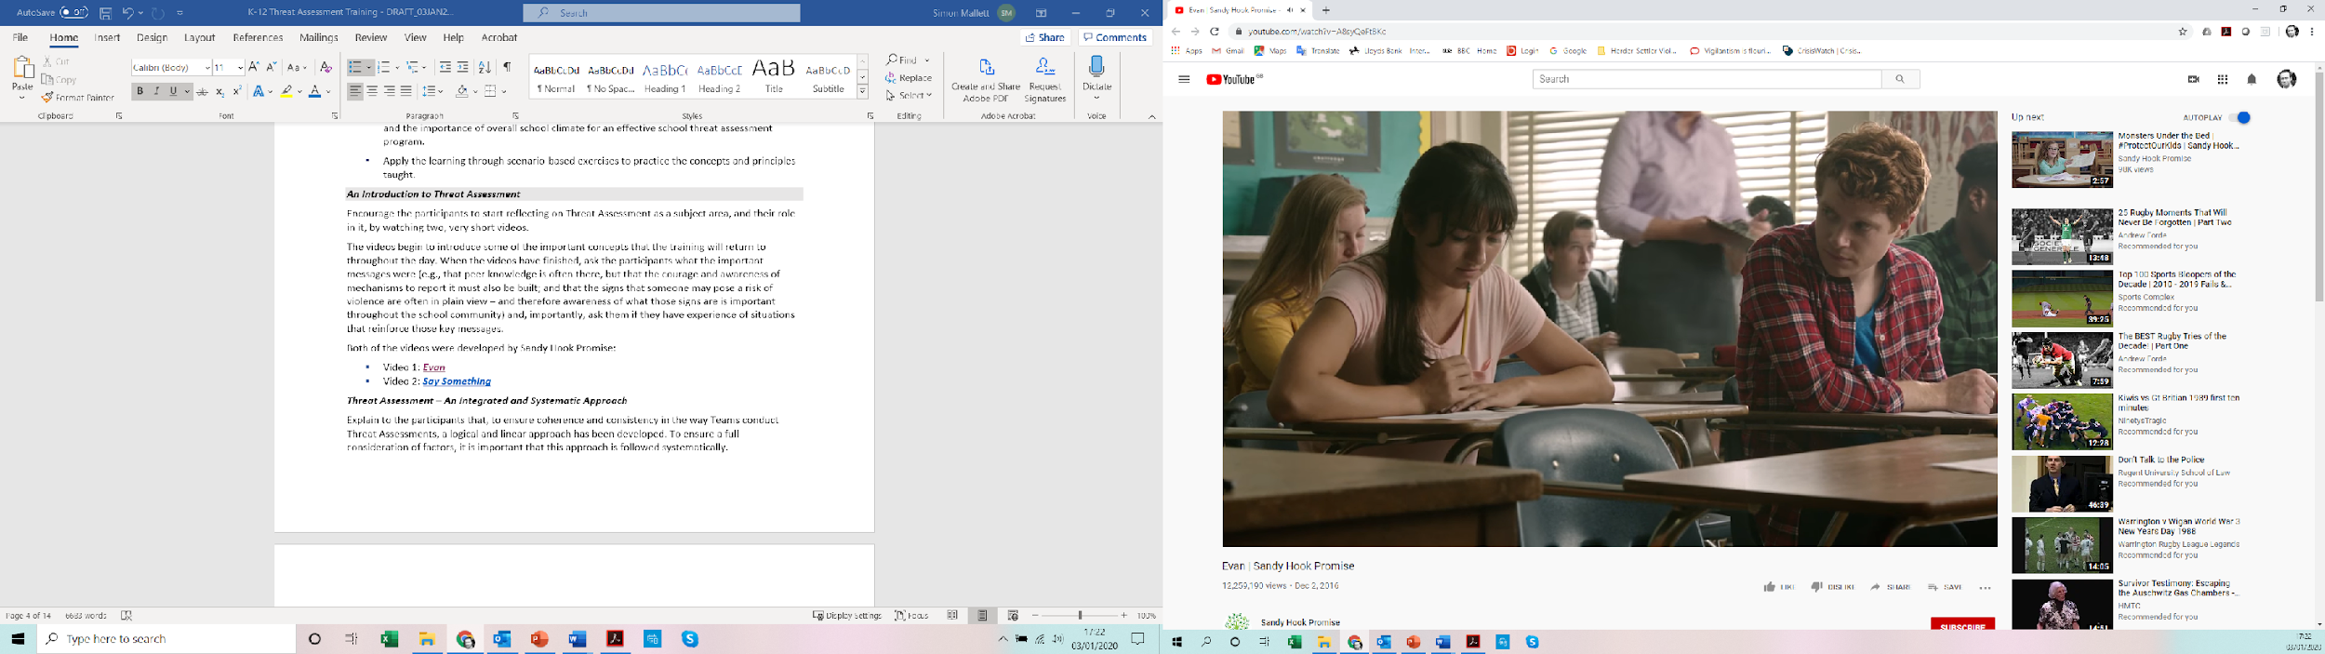
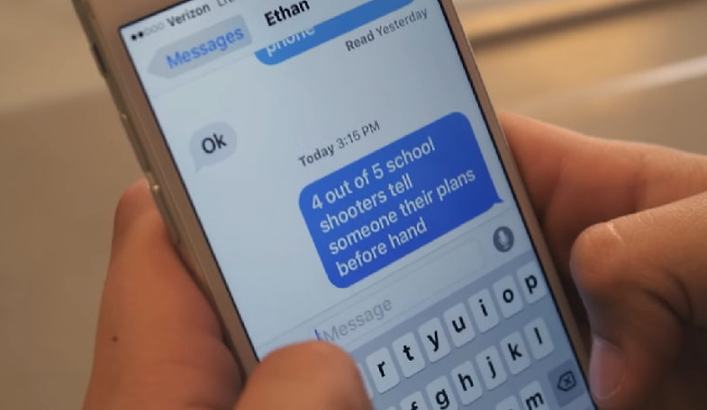
An Introduction to Threat Assessment
Evan
Insert relevant image behind this slide
Insert title of next section here
Say Something

Slide 9
What do we mean by a ‘Threat’?
A concerning communication or behavior that suggests a person may intend to harm themselves or someone else
May be expressed or communicated behaviorally, orally, visually, in writing, electronically, or through any other means
A threat regardless of whether communicated directly to the target or to a third party
A threat can be deduced through an individual’s behavior

Slide 10
What do we mean by a ‘Threat’?
Could be:
  Direct or indirect threats of violence…
  … statements – spoken or written…
  … gestures…
  … acts…
… that a reasonable person would interpret as threatening, unusual or bizarre behavior that would cause a reasonable person to fear injury or harm
Communications or behaviors indicating suicidality
Behavior which is atypical for the person or situation and causes concern for the safety or well-being of those involved
Caution! Implicit bias – TA seeks to eliminate subjectivity and issues associated with implicit bias and equity
Kirwan Institute – Implicit Bias in Education
PDE Equitable Practices Hub

Slide 11

Threats to self and the connection with Threat Assessment
Under Act 18…
“Each school entity shall establish at least one team … for the assessment of and intervention with students whose behavior may indicate a threat to the safety of the student, other students, school employees, school facilities, the community or others.”
And further in the Act…
“Be responsible [for] Assessing and responding to reports of students exhibiting self-harm or suicide risk factors or warning signs as provided for under section 1526 [of the PA School Code, 24 PS § 15-1526, brought into law under Act 71 ].”
What is your interpretation of this language in the Act?
Where do you think the responsibilities of the TAT and Act 71/Crisis Response Teams start and end?

Slide 12
Threats to self and the connection with Threat Assessment
Not the intention of the Act to:
  Create duplication of effort with a school entity’s existing suicide awareness and prevention policies and procedures; or
  Create a requirement that all students presenting with risk of suicide must be overseen by TATs; or
  Create a requirement that all students presenting with risk of suicide must be routed through the threat assessment process set down in this training
Because a single pathway would likely:
  Be inefficient
  Perpetuate misunderstandings about suicide risk among youth that may increase the stigma around help-seeking, which is counter to broader school-based suicide prevention efforts

Slide 13
Threats to self and the connection with Threat Assessment
TATs and Act 71 / Crisis Response Teams need to coordinate efforts
Consider how and when students may need to be referred to and from TATs, and/or the potential points of overlap or intersection
Develop policies and procedures that operationalize this coordination
TATs’ work [and this training] has a significant focus on acts of targeted violence toward others
This is not to minimize suicide risk
PAYS 2023: In the preceding 12 months, of students in grades 8, 10, and 12:
  16.5%, 16.4% and 17.9% respectively had reported considering suicide
  5.3%. 5.4% and 5.9% respectively had attempted suicide
  16.5%, 15.1% and 13% respectively had self-harmed

Slide 14
Threats to self and the connection with Threat Assessment
But it recognizes the following:
Established, mature pathways exist to assess and intervene with those posing a threat to self… and, if procedures to assess and intervene in suicide risk do not currently exist, these should be put in place, but this is not for the TAT to action
Most individuals posing a threat to self do not pose a threat to others
The converse is not true… NTAC Protecting America’s Schools analysis of targeted violence in K-12 settings found:
    41% of the students carrying out the violent acts were motivated by suicide
    For 7%, this appeared to be their primary motive
    An additional 34% had suicidality as a secondary motive
    54% had communicated about, or engaged in behaviors related to, suicide or self-harm

Slide 15
Threats to self and the connection with Threat Assessment
What does this mean in practical terms:
TATs are unlikely to see the majority of students presenting initially with suicidal thoughts or behaviors
This is because these students are rarely a threat to others, and so will be assessed and supported through the established suicide prevention pathways and referred into the TA process only where there are warning signs that may indicate a possible risk to others
For this reason, TATs could never be deemed responsible for the assessment of, and intervention with, all students at risk for suicide
Given the increased risk of suicide among students that pose a risk of violence to others, any student referred to the TAT should be screened for risk for suicide

Slide 16
Threats to self and the connection with Threat Assessment
Members of TATs such as school counselors and school psychologists could act as a pivot, as they will frequently also be responsible for suicide risk screening or assessment within a school entity, providing a natural point of synergy
Or this pivot role could be performed by other TAT members who are members of Act 71 / Crisis Response Teams (e.g., School Safety and Security Coordinator)
TATs should establish protocols for information sharing and follow-up regarding the outcome of a suicide risk screening or assessment for a student who, because they also present a threat to others, will remain involved in the TA process:
  Will avoid risks that parallel efforts are counterproductive / duplicative
  Consideration will need to be given to confidentiality and relevance to case management

Slide 17
Threats to self and the connection with Threat Assessment
TATs must be aware of both warning signs and risk factors for suicide
State suicide risk prevention efforts have strongly encouraged schools to focus primarily on warning signs (not risk factors) to activate their suicide prevention protocols
Risk factors alone should not activate those protocols as schools would find themselves then needing to screen nearly every student (given prevalence of risk factors)
PDE’s Model Administrative Regulations: “Early identification of individuals exhibiting suicide warning signs is vital to the school entity’s suicide prevention efforts
“[However] In the absence of an immediate warning sign for suicide, students demonstrating suicide risk factors that appear to be adversely impacting the student should be referred through an appropriate mechanism (e.g., Student Assistance Program) for follow-up”
 | Prevent Suicide PA Online Learning Center
 | Youth Suicide Education Awareness and Prevention Model Curriculum
 | Suicide in Schools - A Practitioner's Guide to Multi-level Prevention, Assessment, Intervention, & Postvention

Slide 18
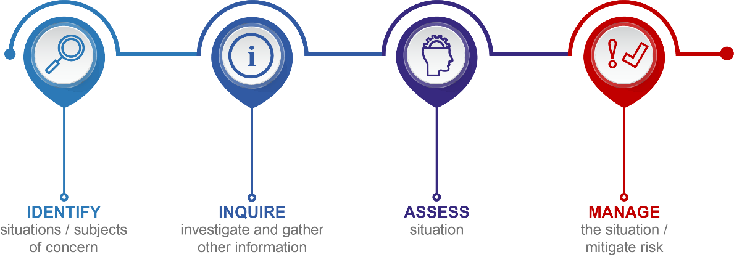
Threat Assessment: An integrated and systematic approach
Developed to ensure TATs can conduct TA in a way that is coherent and consistent
Encouraging bystander reporting is an essential precursor step to the main 4 steps
Integrated: Requiring a multi-agency approach / coordinated action between internal and external stakeholders
Systematic: Process-driven approach that works logically through 4 steps:
The Manage step is defined to reinforce the fact that an assessment of the threat is not a final product, but the beginning of a management process

Slide 19

Rationale for the Threat Assessment and Management Approach

Slide 20
Where does the rationale for our approach come from?
Based on several decades of research that intensified immediately after Columbine
Seminal research published 2004 (U.S. Secret Service and DOE; Safe School Initiative (SSI))
NTAC’s Protecting America’s Schools (2019), compared SSI findings with analysis of more recent incidents
Found original conclusions durable and consistent
 | SchoolSafety.gov USSS Safe Schools Initiative Report
 | USSS Protecting America’s Schools – Analysis of Targeted School Violence
 | FBI Making Prevention a Reality
 | USSS & DOE A Guide to Managing Threatening Situations
 | Defining an Approach to Assessing Risk for Targeted Violence

Slide 21

Where does the rationale for our approach come from?
Research suggests that establishing or enhancing threat assessment capabilities as part of a comprehensive strategy can reduce the likelihood of violence and help address the mental and behavioral health needs of students.
  The 2018 PA School Safety Task Force Report also recommended implementing multidisciplinary threat assessment teams as a best practice.

Slide 22
Fact or Fiction?
School attacks are often sudden, impulsive acts
  Fiction: They are rarely impulsive; attackers typically don’t “just snap”… they decide
People often have no idea of the attacker's ideas or plans
  Fiction: In most cases, other people knew about the attack before it took place
Most attackers threatened their target directly prior to the attack
  Fiction: Majority of attackers did not make direct threats to their target(s) beforehand
Most attackers were “under the radar” showing no indicators they were in need of help
  Fiction: Nearly all engaged in behaviors, prior to their attacks, that caused concern or alarm to at least one person
Averted School Violence

Slide 23
Fact or Fiction?
Most school attackers are suicidal or at a point of desperation prior to their attack
  Fact: Most attackers appeared to have difficulty coping with losses, personal failures or other difficult circumstances and, in many cases, desperation and suicidal ideation was certainly manifest. Most attackers exhibited a history of suicide attempts or suicidal thoughts at some point prior to their attack
Potential school attackers can be identified by certain physical characteristics, personality traits and school history
  Fiction: There are no set of traits that described all – or even most – attackers. The demographic, personality, school history, and social characteristics varied substantially
Meloy, J.R., Hoffmann, J., Deisinger, E.R.D. & Hart, S.D. (2020) ‘Threat Assessment and Threat Management’, in Meloy & Hoffmann (Eds.) International Handbook of Threat Assessment, 2nd Edition. New York: Oxford.
Evaluating the Risk for Targeted Violence in Schools

Slide 24
Fact or Fiction?
Many attackers felt bullied, persecuted or injured by others prior to the attack
  Fact: Almost three-quarters of the attackers felt persecuted, bullied, threatened, attacked or injured by others prior to the incident
Most attackers had access to weapons and experience using them
  Fact: Experience using weapons and access to them was common for many attackers. Nearly two-thirds of the attackers had a known history of weapons use

Slide 25
Fact or Fiction?
Attackers act alone and without the involvement of others
  Fiction: Most carried out their attacks on their own, but many were influenced or encouraged by others to engage in the attacks. Nearly 50% were influenced by others in deciding to mount an attack, dared or encouraged to attack, or both
Most incidents are stopped by law enforcement
  Fiction: Most attacks were stopped by school administrators, educators and students or by the attacker stopping on their own

Slide 26

What does this tell us?
Many acts of targeted violence are preventable… The challenge?
Pieces of the puzzle are usually there; but information is often scattered and fragmented
If we act quickly when we first learn about something concerning then we can figure out who might have some relevant information
To do this, we need to set a low bar to trigger the TA process
In evaluating information, ask: Is the subject of concern on the pathway to violence?

Slide 27



The Path to Violence
Insert relevant image behind this slide
Insert title of next section here
 | PBS Path to Violence
Notes:
Navigate to the Video titled PBS After Newtown | The Path to Violence in the Additional in-Module Online Video Resources section of the webpage.

Slide 28
Reflect on this from the National Threat Assessment Center
When establishing threat assessment capabilities within K-12 schools, keep in mind that there is no profile [of an attacker]. There have been male and female attackers, high-achieving students with good grades as well as poor performers. These acts of violence were committed by students who were loners and socially isolated, and those who were well-liked and popular.
Rather than focusing solely on a student’s personality traits or school performance, we can learn much more about a student’s risk for violence by working through the threat assessment process, which is designed to gather the most relevant information about the student’s communications and behaviors, the negative or stressful events the student has experienced, and the resources the student possesses to overcome those setbacks and challenges.
U.S. Secret Service National Threat Assessment Center, July 2018
Operational Guide for Preventing Targeted School Violence

Slide 29
Section 2 | The Principles of Threat Assessment

Slide 30
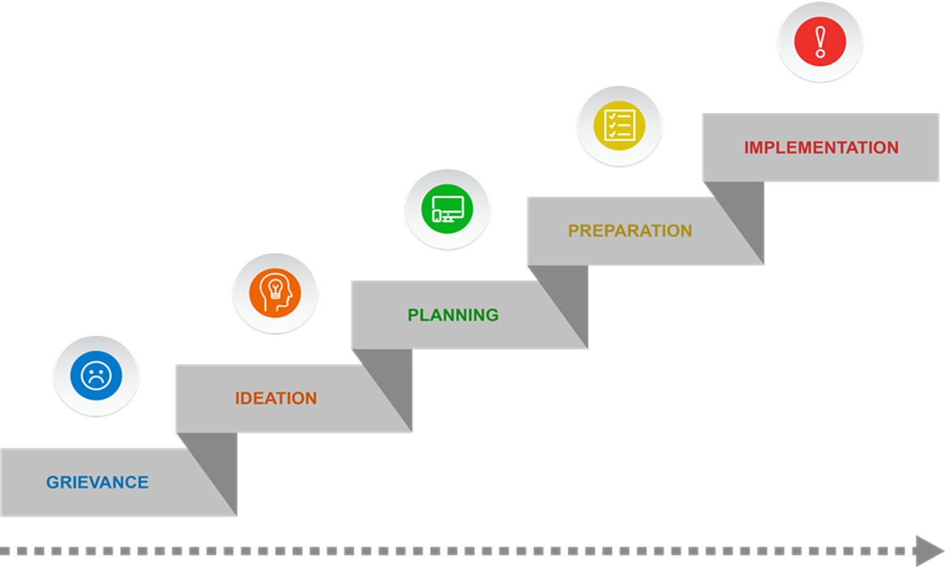
The principles of Threat Assessment | Pathway to Violence
Targeted violence is the end result of an understandable, and frequently discernible, process of thinking and behavior known as the Pathway to Violence

Slide 31

The principles of Threat Assessment | STEP©
Targeted violence stems from an interaction among the subject(s), the target(s), the environment and the precipitating events
©Deisinger & Randazzo (2008)

Slide 32
The principles of Threat Assessment
Threat assessment is about prevention, not prediction
Focus must be on the central question: Whether an individual poses a threat, not just whether the person has made a threat
An inquisitive, objective and diligent mindset is critical to successful TA
Effective TA is based upon observations of behavior, rather than on characteristics –Behavioral Threat Assessment – a deductive process
Very different to profiling – an inductive process asserting certain traits are predictive of the probability an individual will engage in a certain form of behavior
Violence is a dynamic process. No one is either always dangerous or never dangerous

Slide 33
The principles of Threat Assessment
An integrated systems approach should guide threat assessment investigations
Relationships with agencies and service systems within the school and community are critical to identifying, assessing, and managing individuals on a path to violence
Social media and on-line activity are often critical considerations
The relationship between mental illness and violence is complex. Serious mental illness increases general risk of violence, but is not the major factor that it is perceived to be and is almost never the sole or primary explanation for a violent act
Proactivity to ensure individuals who may pose a threat are identified and intercepted early is necessary; achieved by setting a low bar to triggering TA

Slide 34

The principles of Threat Assessment
Over-react… Unintended consequences of ‘coming down hard’… Impact on school climate… ‘Alert fatigue’ within school community and partner agencies / professionals
Under-react… bar too high… Missed opportunities to positively intervene and support… too little, too late…
TA is a mechanism that is logical, can be trusted and seeks to remove subjectivity

Slide 35
Section 3 | Responsibilities and Composition of Threat Assessment Teams

Slide 36
Code-mandated responsibilities of Threat Assessment Teams
Assessing and intervening with individuals who may pose a threat to self or others
Ensuring school employees know:
  Who the Team members are
  How – and to whom – to report threatening or at-risk behavior, including through Safe2Say Something
Reporting quantitative data to the Chief School Administrator / designee on the Team’s activity
Additionally recommended to provide advice, guidance, awareness raising materials and training to the whole school community on recognizing threatening or aberrant behavior, and how to report it

Slide 37
Code-mandated responsibilities of Threat Assessment Teams
In addition, Teams are to:
Upon a preliminary determination that a student may pose a threat of violence or physical harm to self or others, notify the chief school administrator or a designee, the student's building principal and the school safety and security coordinator
The building principal or designee will immediately attempt to notify the student’s caregiver*, unless abuse or neglect are suspected, in which case CPS would be notified, and not the student’s caregiver
*This general reporting requirement does not stop school employees from acting immediately to address an imminent threat

Slide 38
Code-mandated responsibilities of Threat Assessment Teams
Act 55 of 2022 amended Article XIIIE (Threat Assessment) to specify new training, education, and awareness requirements:
All school entities must annually facilitate opportunities for members of threat assessment team to complete group or individualized training
School entities, over and above the recommendation to provide advice, guidance, awareness raising materials and training to the whole school community on recognizing threatening or aberrant behavior, and how to report it, must also annually ensure that students, school employees, and parents/guardians are informed of the existence and purpose of the school entity’s threat assessment team(s)
School entities must provide training to school employees (online or in person) on a range of safety and security related subjects, which can include threat assessment

Slide 39
Composition of Threat Assessment Teams
As a minimum, each Team is to include individuals with expertise in:
  School health
  Counseling, school psychology or social work
  Special education
  School administration
  + School Safety Coordinator
This composition of TAT members should not be understood as the final composition… A core team of 3-5 members, augmented by others…
Who in your school might fulfill these roles?
Can members fulfill more than one role?
Who else could be beneficially included either as a sitting member of a TAT or as someone called in on an ad hoc basis where specialized expertise would be of value?

Slide 40
Section 4 | Conducting Threat Assessments – The Process in Overview

Slide 41

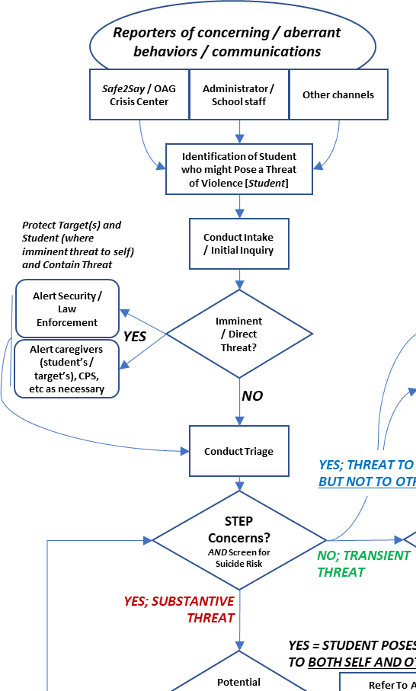
Conducting Threat Assessments – The Process in Overview

Slide 42
Section 5 | Identifying and Reporting Threats

Slide 43
The importance of reporting
Identifying individuals or situations of concern depends upon the willingness and ability of the school community to communicate with the TAT...
…and the ability to recognize warning signs
Early intervention to manage threats is best achieved when the whole school community are encouraged to report any threats or other behavior that they find troubling or upsetting
However, TATs must be cognizant of the difference between reactive aggression (handled in most cases through established conduct and discipline mechanisms) and proactive aggression (what TA deals with)
How can we educate the school community on what to be alert for and how and when to report? And do so without creating a climate of fear and mistrust?

Slide 44
Reactive and proactive aggression and violence
Reactive
Fight or flight response to a perceived threat
Fueled by adrenaline
Aggressors lose control
Emotional / tantrum
Goal: Threat Reduction – self-defense
Proactive
Conscious response
Fueled by intent
Little or no emotion
Predatory
Goal: Multiple… notoriety, revenge, status, money, power, assumption of control over destiny, promotion of religious or political beliefs…
…anything that the subject rationalizes will be ‘won’ by their actions
Remember… Attackers don’t snap. They decide

Slide 45
Behaviors notifiable to Law Enforcement
PA School Code and wider state law requires a number of incident types to immediately be reported to law enforcement, including:
Homicide
Aggravated assault
Stalking
Kidnapping
Unlawful restraint
Rape
Sexual assault
Arson
Institutional vandalism
Burglary
Criminal trespass
Riot
Possession of a firearm by a minor
Possession, use or sale of a controled substance or drug paraphernalia

Slide 46
Behaviors notifiable to Law Enforcement
Regardless of law enforcement action, Teams should conduct their own assessment to ensure the school is ready to respond to any risks / offer supportive interventions
TATs must be familiar with these as they may discover criminal allegations or concerning behaviors as to criminal behavior in the process of their work
Note, however, this reporting is a school administration duty, not a TAT duty
In addition, school entities must immediately notify, as soon as practicable, the caregiver(s) of a victim or suspect directly involved in these incidents
Caregivers must be informed as to whether the local police department has been, or may be, notified of the incident
Again, while not a duty of the Team, in practical terms, where this relates to a TA case, it may well be the TAT who make the notification
TATs must be clear on the procedures related law enforcement notification associated with students with a disability

Slide 47
Reportable behaviors and ‘Leakage’
Threat: A concerning communication or behavior that suggests a person may intend to harm themselves or someone else… It is an expression of intention to inflict injury or damage and often one of the first ways a person of concern may be identified
Could be an actual expression of intent to do harm, a “leakage” of violent thought, or an inappropriate statement
Leakage: Communication to a 3rd party of an intent to do harm to a target
Communication varies: Planned or spontaneous utterances, letters, diaries, emails, journals, social media posts, text messages, video recordings...
Leakage could be intentional or unintentional
Fact: Behavioral Threat Assessment research finds leakage very frequently occurs
Why might leakage be intentional on the part of the subject?
The Concept of Leakage in Threat Assessment

Slide 48
Reportable behaviors: Examples
Physical violence toward a person or property
Direct or indirect threats of violence
Bullying that continues after interventions to stop the behavior
Possession of weapons on school grounds or school events
Any statements or behaviors indicating suicidal thoughts or behaviors
Any behaviors or communications that suggest the individual has engaged in:
  Research or planning related to carrying out a targeted attack
  Efforts to acquire the means to engage in an attack
  End of life planning

Slide 49
Reportable behaviors: Other concerning behaviors
Any act, gesture or statement that would be interpreted by a reasonable person as threatening or intimidating, such as:
  Overt physical or verbal intimidation
  Throwing objects or other gestures intended to cause fear
  Making contextually inappropriate statements about harming others
Unusual or bizarre behavior that would cause a reasonable person to fear injury or harm due to its nature and severity, such as:
  Stalking
  Erratic or bizarre behavior suggestive of mental disturbance or substance abuse
  Fixation with mass murder, weapons, or violence generally
  Fixation with hate group, terrorist, or extremist material

Slide 50

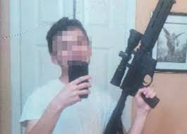
Are those guns real…?
Insert relevant image behind this slide
Insert title of next section here
Notes:
Click on the Pictures to play the videos

Slide 51


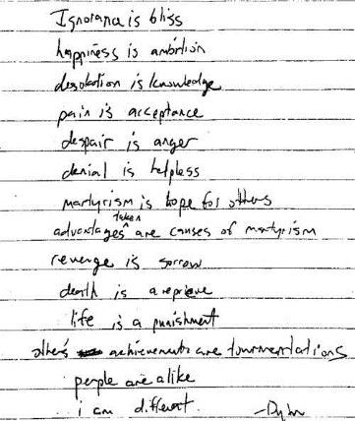
They’re all on my hit list…
Insert relevant image behind this slide
Insert title of next section here
Notes:
Click on the Pictures to play the videos

Slide 52


I’m really worried about him…
Insert relevant image behind this slide
Insert title of next section here
Notes:
Click on the Pictures to play the videos

Slide 53
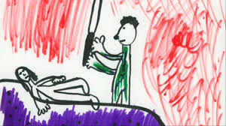


Creepy Pasta drawings
Insert relevant image behind this slide
Insert title of next section here
Notes:
Click on the Pictures to play the videos

Slide 54
Who reports, and how to report
The ability of TATs to assess and intervene early is contingent on all potential reporters – the school community as a whole - being:
  Clear on what represents concerning or aberrant communication and behavior
  Having confidence their concerns will be heard – and by whom and by what process
Requires the TAT to ensure the school community:
  Can recognize concerning or aberrant behavior and communication
  Know the reporting channels and the TA process and personnel reports will ‘activate’
Who are threats reported to in your context?
How is this known to the school community?

Slide 55

Who reports, and how to report
Create multiple channels… all staff have a pastoral care role…
Focus on fostering a positive school climate so barriers to reporting are broken down
Safe2Say Something
Act 44 required the establishment of Safe2Say, but it does not create mandated reporting requirements
Instead, school entities must develop procedures for assessing and responding to reports received through the Safe2Say Program
School entities do not report information to Safe2Say Something

Slide 56
Barriers to reporting
Bystanders: Anyone positioned to have awareness of risk factors or to observe warning behaviors related to a person who may be considering acting violent
Upstanders: This is what we want bystanders to be… willing to report what they know or see to a caring adult, someone in a position of authority at school or to law enforcement
School climate affects whether bystanders come forward with information
What might create barriers to reporting? How can we overcome these?
USSS & DOE Prior Knowledge of Potential School-Based Violence

Slide 57
Overcoming barriers to reporting
There is no penalty for good faith reporting, even if the behavior seems low-level or unclear
Open up discussions with the school entity solicitor on civil liability immunity as governed by local law. The context where guidance would be sought would relate to:
  Whether immunity from civil liability would exist…
  …in circumstances where, in good faith with reasonable cause and without malice…
  … school personnel including TATs, but also the wider community of reporters which will include caregivers and students…
  … reports, investigates, or causes an investigation to be made into information that any person poses a credible danger of serious bodily injury or death to any other person on school property...
  ...or fails to report, investigate or cause an investigation to be made, in circumstances where they might reasonably be expected to have done so.

Slide 58
Overcoming barriers to reporting
Under state law, Teams must ensure that school employees: 1). Are aware of who TAT members are and how to report threatening or at-risk behavior; 2). Have access to informational materials regarding recognition of threatening or at-risk behavior that may present a threat
TAT’s effectiveness contingent on educating the whole school community
Team’s efforts are oriented around assistance, not punitive actions…
…emphasize reporting as an act of caring; not “snitching” or “tattling”
Provide multiple ways to report a concern
Create a culture of shared responsibility helps turn bystanders into upstanders
“Loop back” with anyone who reports a threat to let them know their report led to a better understanding of the situation and allowed interventions to be put into place

Slide 59
Section 6 | Gathering Information

Slide 60
The focus of information gathering
Behavioral Threat Assessment and Management is a fact-based process
Gathering information – the facts upon which analysis and assessment is performed – is centrally important
Potentially enormous amount of information; requires a coherent approach to how we gather information
Continuously reflect on all parts of STEP to ensure vital information is not missed
Focus on NTAC’s investigative themes… These are evidence-based, good practice
For each of the themes, pose a question that will open up the line of inquiry

Slide 61
Investigative themes
Motive
What are the student’s motive(s) and goals? What first brought them to someone’s attention?
Communications
Have there been any communications suggesting ideas, intent, planning or preparation for violence?
Inappropriate Interests
Has the student shown any inappropriate interest in, fascination, and / or identification with other incidents of mass attacks or other acts of targeted violence?

Slide 62
Investigative themes
Weapons Access
Does the student have (or are they developing) the capacity to carry out an act of targeted violence?
Stressors
Has, or is, the student experiencing stressful events, such as setbacks, challenges or losses or are there circumstances that might affect the likelihood of an escalation to violent behavior?
Desperation or Despair
Is the student experiencing hopelessness, desperation, and/or despair?

Slide 63
Investigative themes
Mental Health Disorders and Developmental Issues
Does the individual have a diagnosed mental health disorder or developmental issue or exhibit behaviors that suggest they may have a mental health disorder or developmental issue?
Violence as an Option
Do they see violence as an acceptable, desirable (only?) way to solve a problem?
Concerned Others
Are other people concerned about the individual’s potential for violence?

Slide 64
Investigative themes
Planning and Capacity to Carry Out an Attack
Does the student have the ability, intent and will to plan and carry out an attack?
Consistency
Are the student’s conversation and “story” consistent with his or her actions?
Protective Factors
Does the student have a positive, trusting, sustained relationship with at least one responsible person?

Slide 65

Potential Sources of Information – Group Work Exercise
Insert relevant image behind this slide
Insert title of next section here

Slide 66
Sources of information
Background Information
Recent and historical school or work performance history
Prior TAT contact(s)
Contact with law enforcement or security at school and in the community
Student records
Other Sources of Information
Information from the threat recipient, witnesses, target, student, caregivers, teachers and others who regularly interact with the individual
Social media presence
Internet usage / search history
Criminal records
Search of person, property, locker and/or desk
Information from previous schools
Information from community-based medical or mental health providers

Slide 67
Access health records and behavioral history
Upon a preliminary determination a student's behavior may indicate a threat to the safety of the student, other students, school employees, school facilities, the community or others … to facilitate the timely assessment of, and intervention, a Team shall (Art. XIII-E § 1302-E (d)) have access to the following student information to the extent permissible under State and Federal law:
  Student health records
  Prior school disciplinary records
  Records or information relating to court adjudication (through juvenile probation)
  Records of any prior behavioral or mental health or psychological evaluations or screenings maintained by the school entity
  Other records or information that may be relevant to evaluating a threat or determining treatment or referral options for a student that are maintained by the school entity, e.g., SAP referrals

Slide 68
Access to health records and behavioral history
There is a general principle that where school entitles request information from county agencies / juvenile probation service, those recipients shall comply…
…However, there are constraints on access, associated with:
  42 Pa.C.S. § 5944 relating to confidential communications to psychiatrists or licensed psychologists
  The Family Educational Rights and Privacy Act (FERPA)
  Individuals with Disabilities Education Act (IDEA)
  Health Insurance Portability and Accountability Act (HIPAA)
  DHHS prohibitions and limitations relating to the confidentiality of drug and alcohol treatment records
in many cases however, there are exemptions associated with cases where there is an assessed threat to life or other emergency

Slide 69
Access to health records and behavioral history
Any information gained from health records or behavioral records is to enable the Team to fulfil its duty to:
  Evaluate a threat or the recommended disposition of a threat…
  …and, no member of a team may redisclose any record or information obtained [through exercise of their Code-mandated authority] or otherwise use any record of a student beyond the purpose for which the disclosure was made to the team
Documentation maintained by the TAT is not subject to PA Right To Know Law
How can obstacles to gaining allowable access to behavioral and mental health records and criminal history be overcome?

Slide 70
Access to health records and behavioral history
Information is gathered in collaboration with the school entity’s safety and security office, or other central office level staff, with legal advice / oversight where relevant
Simplest option: Obtain permission from caregivers for records to be disclosed
If not practical / getting results: Consider (with legal advice) whether Tarasoff Rule applies
Tarasoff obligates mental health providers to use reasonable care to protect the victim of a threat of violence

Slide 71
Obligations under Family Educational Rights and Privacy Act [FERPA]
Does not apply to oral communication between educators and others concerning information or knowledge that does not rely on the education record
Does not stop a school official from disclosing information about a student if the information is obtained through the school official's personal knowledge or observation, and not from the student's education records
May not apply to images of students captured on CCTV or other security cameras maintained by the school’s ‘Law Enforcement Unit’ [LEU]. In many cases, FERPA will not apply, but consultation with your solicitor is advised in relation to the specific context presented by your school entity

Slide 72
Obligations under Family Educational Rights and Privacy Act [FERPA]
LEU: Police officers or security staff employed or authorized by the school to monitor safety and security in and around school premises, or specifically designated school officials responsible for referring potential or alleged violations of law to local police authorities
Investigative reports / other records created and maintained by LEU are not considered subject to FERPA
These can be disclosed, including to outside LE, without the consent of caregivers
Education Record Disclosure exceptions under FERPA:
In an emergency, school officials are permitted to disclose education records without consent to protect the health or safety of students or other individuals

Slide 73
FERPA’s Relationship with Health Insurance Portability and Accountability Act [HIPAA]
DOE & DHHS guidance on relationship between FERPA and the HIPAA Privacy Rule:
Disclosures to Prevent a Serious and Imminent Threat: Health care providers may share PHI with anyone as necessary to prevent or lessen a serious and imminent threat to the health or safety of the individual, another person, or the public … This permission includes the sharing of psychotherapy notes, which otherwise receive special protection under the [HIPAA] Privacy Rule.
Thus, without a patient’s authorization or agreement, health care providers may disclose a patient’s health information to anyone who is in a position to prevent or lessen the threatened harm, including family, friends, caregivers, and law enforcement.
DOE & DHHS Guidance on Application of FERPA and HIPAA to Student Health Records

Slide 74
Response to a reported threat
Use a standardized protocol for gathering information and for interviewing:
  Who will interview students who might pose a risk for violence?
  Who will talk to classmates, teachers, or caregivers?
  How will information gained through interviews be documented?

Slide 75
Response to a reported threat: Initial interviews to verify a reported threat
Where threat is not imminent, circumstance will help determine who and when to interview
Student who might pose a threat of violence may be among the last to be interviewed
Goal of initial interviews: Evaluate the potential threat in context and consider:
  Student’s explanation of the threat’s meaning
  Perceptions of the threat’s meaning by the target / witnesses
Record an interviewee’s exact words
Initial interviews should begin with open ended questions
Ask witnesses and potential targets about their perceptions, feelings and interpretation of the student’s communication or behavior
Ask the student about their statements / behavior

Slide 76
Response to a reported threat: Initial interviews to verify a reported threat
Initial information gathering should include developing an understanding of the motivation of the individual who initially reported the threat
This includes an understanding of the relationship between the reporter and the individual of concern
The possibility that reports may be made for malicious / spurious reasons must be considered as a possibility and ruled out as part of TA
In questioning the student, you are trying to gain an understanding of the context in which their behavior occurred, their intentions and motivations, their understanding of the impact of their behavior on others and their future plans

Slide 77
Intake and Initial Inquiry
Extent of information gathering undertaken impacted by the level of concern presented by the individual and / or the situation
The initial information gathered is reviewed by a subset of the full Team. Goal: To determine whether the threat can be quickly and easily resolved and whether existing resources and mechanisms are sufficient to address those concerns
The Intake and Initial Inquiry step also answers the critical question: Is there an imminent or direct threat posed by the subject / situation?
If yes, immediate protective actions need to be taken and, dependent on the nature of the concern, notification to Law Enforcement
Crisis response procedures (school entity’s EOP) would be initiated and the TA ‘paused’
Once safety of student, target and environment are established, TAT can reconvene

Slide 78
Intake and Initial Inquiry > Triage
Now the scope of the TA broadens to include more people and more information to develop a holistic view of the student who might pose a threat of violence / situation
Triage will more fully develop lines of inquiry using STEP© as a framework, whether undertaken once actions to mitigate an imminent threat have been taken, or carried out where the Intake and Initial Inquiry step determined there was no imminent threat
To perform triage, readily accessible information is gathered: interviews, records checks
At the conclusion of Triage step:
  If it cannot be determined with a reasonable degree of confidence that the subject of concern is no threat or presents only a low level of concern, a full Inquiry is undertaken by the full TAT and the subject / situation of concern are determined to pose a Substantive Threat
  If Triage determines no threat / low level of concern (Transient Threat), case is either documented and closed or referrals / other supports to address remaining concerns occur

Slide 79
Intake and Initial Inquiry > Triage
A third determination is also possible
That the individual poses no threat to others but does pose a threat to self
These cases will be rare
If the TAT observe warning signs or risk factors for suicide risk, but no indicators of a threat to others:
  Student should be immediately referred to the Act 71 team / Crisis Response Team
  The TA case would be closed
  If the Act 71 team / Crisis Response Team subsequently identify potential for threat to others, the student would be referred back into the TA process

Slide 80
Follow-up after triage: Focus of interviews
What should interviews with the following focus on:
Teachers / other school staff?
Classmates or other peers?
Caregivers?
The student who might pose a threat of violence?
Full corroboration of information across these sources will be powerful in helping to assess the level and nature of the threat…
…but what might significant differences in the information provided by these sources reveal?

Slide 81
Are those guns real…?
Insert relevant image behind this slide
Insert title of next section here
Notes:
Click on the Pictures to play the videos

Slide 82
I’m really worried about him…
Insert relevant image behind this slide
Insert title of next section here
Notes:
Click on the Pictures to play the videos

Slide 83
Creepy Pasta drawings
Insert relevant image behind this slide
Insert title of next section here
Notes:
Click on the Pictures to play the videos

Slide 84
Section 7 | Assessing the Situation

Slide 85
Assessing the situation and classifying threats
We use the information gathered to determine whether the threat is classified as:
  Low Risk Threat - Low Level of Concern – Transient Threat unless other STEP© concerns
  Moderate Risk Threat - Moderate Level of Concern – Substantive Threat at Moderate Risk / Level of Concern and beyond
  High Risk Threat - High Level of Concern
  Imminent Threat
  Direct Threat
Classification as No Concern is also possible and so is that the individual poses no threat to others but does pose a threat to self

Slide 86
Are those guns real…?
Part 3
Insert relevant image behind this slide
Part 4
Insert title of next section here
Notes:
Click on the Pictures to play the videos

Slide 87
I’m really worried about him…
Part 4
Part 3
Insert relevant image behind this slide
Insert title of next section here
Notes:
Click on the Pictures to play the videos

Slide 88
Section 8 | Managing Threats

Slide 89

Goals of threat management
Control the situation/individual to prevent the possibility of violence
Protect and aid possible targets to the extent possible
Provide support and guidance to help individuals deal successfully with their problems
STEP© can provide a useful framework for approaching threat management coherently:
  S: De-escalate, contain, or control the individual who may take violent action
  T: Decrease vulnerabilities of the target
  E: Address environment and systems to discourage escalation
  P: Prepare and mitigate against precipitating events that may trigger adverse reactions

Slide 90
Subject [Student posing a threat of violence]
Threat Management responses generally fall into: (1). Discipline; (2). Behavioral interventions and supports; (3). Mental health support and skill-building
Examples of strategies:
  Increasing engagement to build rapport, decrease isolation, problem solve about grievances, monitor reactions to interventions and precipitating events
  Referral to SAP for assistance with academic, behavioral or social-emotional challenges
  Referral for in-school / community-based mental health assessment and/or special education or 504 Plan evaluation via MDT/CST
For students not identified with a disability, consider whether the information gathered suggests a referral to consider special education eligibility is appropriate

Slide 91
Subject [Student posing a threat of violence]
Disciplinary actions / behavioral interventions… admonition and counseling, behavioral contracts, change class, short / long term suspension, alternative school placement or expulsion
If behavior / communication of concern was Code of Conduct / school board policy violation, all disciplinary procedures followed, and student poses a significant risk to the health or safety of others that cannot be eliminated by a modification of policies, practices, or procedures, or by the provision of auxiliary aids or services…
…the direct threat standard may be used to remove the student
If a student posing a risk for violence is identified with a disability:
  Follow due process under IDEA prior to taking actions which would constitute a change in placement
  Consider referral to IEP team... Changes to goals, services, accommodations or placement warranted?

Slide 92
Target
TATs operate under the duty to both Warn and Protect individuals who may be under threat, at all times reiterating that the situation is not their fault, minimizing the risk of self-blame, and ensuring supports are available for them:
Inform the target (and caregiver if a student) as to the nature of the threat and who the student at risk for violence is
Provide coaching regarding personal safety approaches in dealing with the student at risk for violence
Provide supportive counseling
Support / implement strategies to minimize the target’s contact with the student posing risk for violence
Act 110 of 2020 protects students who are victims of sexual assault from having to attend the same school as the individual convicted or adjudicated delinquent of sexual assault against them

Slide 93
Environment and Precipitating Events
Implement a trauma-informed approach to create a trauma-informed school community
Enhance bullying prevention programs
Assess school / workplace climate and support efforts to build a caring community
 | PDE School Climate Hub National School Climate Center
 | Bullying Prevention – stopbullying.gov
 | Model Trauma-Informed Approach Plan
 | National Center on Safe Supportive Learning Environments
Intervene with others that support or encourage the individual’s violent behavior
Take steps to increase social-emotional learning and mental health awareness across the school
Strengthen suicide prevention programs
Assign a case manager to monitor the student posing risk for violence and notify the Team of any change in status or exacerbation of stressors – including “last straw” / triggering events

Slide 94
Coordinating with others
TA is designed to work in conjunction with, and not in place of, existing programs and frameworks, including:
  Student Assistance Program (SAP)
  Multi-Tiered Systems of Support (MTSS)
  Positive Behavior Interventions and Support (PBIS)
  School climate initiatives
  Trauma-informed approaches
  Social-emotional learning
  Suicide prevention and awareness
It is vitally important that these Teams can work together and not in isolation or in conflict

Slide 95
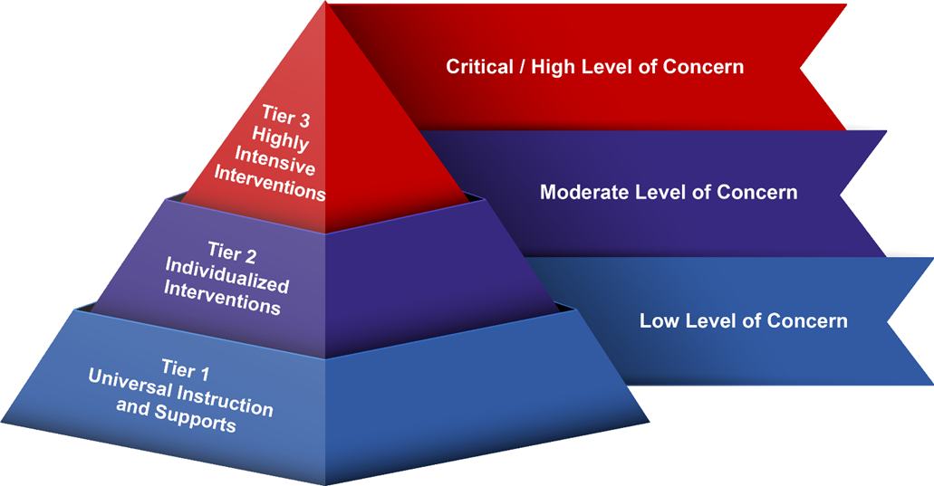
Tiered interventions
STEP enables us to track the complex, multi-factor nature of BTAM cases from Inquiry to Management
TATs can additionally use MTSS to help determine the specific mix / intensity of interventions
M TSS provides a framework for responding to situations of concern – whether those involving TA or complementary / parallel processes associated with academic performance, behavior and social-emotional wellness
Must be applied holistically

Slide 96
Tiered interventions
Tier 1: Foundation for the MTSS framework and encompasses the entire school / practices that contribute to a positive school climate…
… proactive classroom management strategies, positive relationships between staff and students, clear and objective behavioral expectations, PBIS, social-emotional learning curricula, restorative practices...
Tier 2: Individualized, targeted interventions to address underlying factors…
… in-school group counseling to develop coping, self-regulation and / or peer relationship skills, academic supports, check in / check out, behavior contract, referral to community based resources, assignment of a mentor…

Slide 97
Tiered interventions
Tier 3: Highly intensive, individualized interventions and supports…
… multi-agency involvement, potentially criminal charges / high discipline consequences, potential change in educational placement, SPED eligibility or placement, referral for mental health assessment, increased supervision and monitoring, FBA, BIP…

Slide 98
Re-entry plans
Purpose: Identify and address issues that led to the crisis
Required for any student returning to school after a high-risk threat to self or others
Case manager contacts caregiver(s) to arrange the meeting. If arranged by phone, a notification letter should be given to the caregiver(s) on the day of the meeting
Team should secure a release to exchange information with the student’s mental health provider, if student is in treatment
If a disability is suspected, refer to the MDT / CST
Who should be included in the re-entry team meeting?

Slide 99
Re-entry plans
Supports listed in the re-entry plan as actions to be taken by the school, caregiver, or student
Ensure actions are assigned to a named individual
Case Manager responsible for communicating the plan within the TAT and other school staff, for monitoring it and reconvening TAT if necessary
Team, caregivers, student sign the plan and copy given to caregivers and student
Plan should be attached and stored with the threat management case record
If determined the student poses a continued threat of violence, TAT will develop, implement, and monitor an individualized Safety Plan

Slide 100
Safety plans
Purpose: To establish and maintain consistent measures to follow in cases when a student displays unsafe behavior AND is considered at risk for future unsafe behavior
Must be individualized
Addresses a specific behavior that is dangerous to the student / others
Safety Plans will generally cover:
  Description of the specific unsafe behaviors and warning signs or triggers
  Crisis Response Plan
  Strategies known to be effective in de-escalating the situation
  Supports to be put in place to lessen the likelihood of the unsafe behavior
  Plan for monitoring and terminating the plan

Slide 101

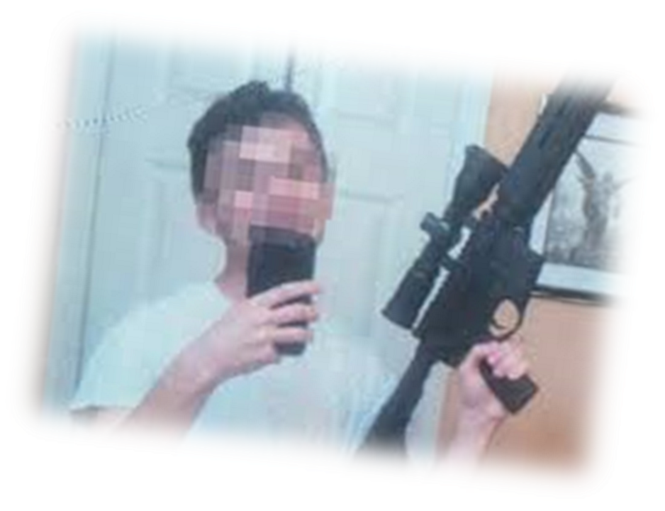
Managing Threats – Discussion Exercise
Moderate Risk Threat
Insert relevant image behind this slide
High Risk Threat
Insert title of next section here

Slide 102

Questions….
Final Group Thoughts & Questions

Slide 103

Further Information
PA Threat Assessment Technical Assistance Network
pak12tanc@rsmconsulting.us

